Slide 1
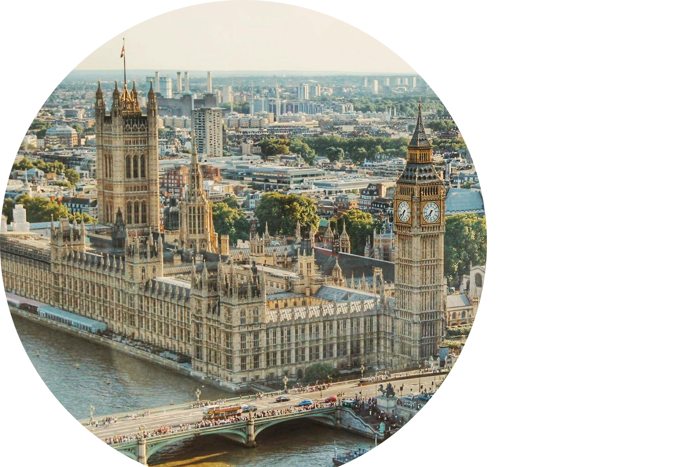
POLLING OF MPS
JULY 2025 – CONDUCTED BY YOUGOV

Slide 2
Sections
1 Methodology
2 Importance of an independent regulator
3 Health of local journalism
IPSO / YouGov

Slide 3
1 Methodology
YouGov completed online interviews with a representative sample of 103 MPs;
The survey was completed between 1st and 19th July 2025;
All results are based on a sample and are therefore subject to statistical errors normally associated with sample-based information;
Any percentages calculated on bases fewer than 30 unweighted respondents must not be reported as they do not represent a wide enough cross-section of the target population to be considered statistically reliable. However, due to the 2024 election we now see a base of size fewer than 30 for the main opposition party. For the purpose of consistency, we will be reporting the two major parties (Labour and Conservative) throughout this report;
Results for MPs are weighted by party, gender, electoral cohort, and geography to give a sample that is representative of the House of Commons;
Based on a 95% confidence level results are correct to +/- 9%.
IPSO / YouGov

Slide 4
2 Importance of an independent regulator
Over nine-tenths of MPs say it is important to have an independent press regulator
IPSO / YouGov
How important, if at all, do you believe it is to have an independent press regulator, not influenced by government?
Base: Total MPs (103), Labour MPs (73), Conservative MPs (19)
Data labels lower than 4% have been removed for clarity

Slide 5
3 Health of local journalism
Local journalism is…
Which ONE of the following best describes your view of local journalism? Please select the option that best applies.
Base: Total MPs (103), Labour MPs (73), Conservative MPs (19)
Data labels lower than 4% have been removed for clarity
IPSO / YouGov

Slide 6
IPSO / YouGov

